Slide 1
Microsoft Pictures Presents
Where to Invest in Profitable Film Projects
Analysis by Patrick Anastasio

Slide 2
Business Summary
Analysis of industry data reveal opportunities for success through smart investment in:
Popular and highly rated genres
With a proven net profit in the domestic market
Attach names of buzzworthy directors

Slide 3
Outline
Business Problem
The Data
The Method
Results
Conclusions

Slide 4

Business Problem
Movie Production is a “Risky Business”
As a fledgling production company, Microsoft lacks experience and industry knowledge.
You have asked me do provide analysis on
what projects will be profitable, popular, and bring buzz to the company?

Slide 5
The Data
Datasets from movie aggregation sites:
Movies by title, ratings, audience popularity, genres, names of directors, budgets and domestic box office numbers.
IMDB
TheMovieDB
The Numbers

Slide 6
The Method
I have used data analysis and graphing to show what and who has been successful in the industry.
I merged several datasets from different sources and extracted the relevant information.
I then analyzed that information
Finally, I used visualizations to present my results

Slide 7
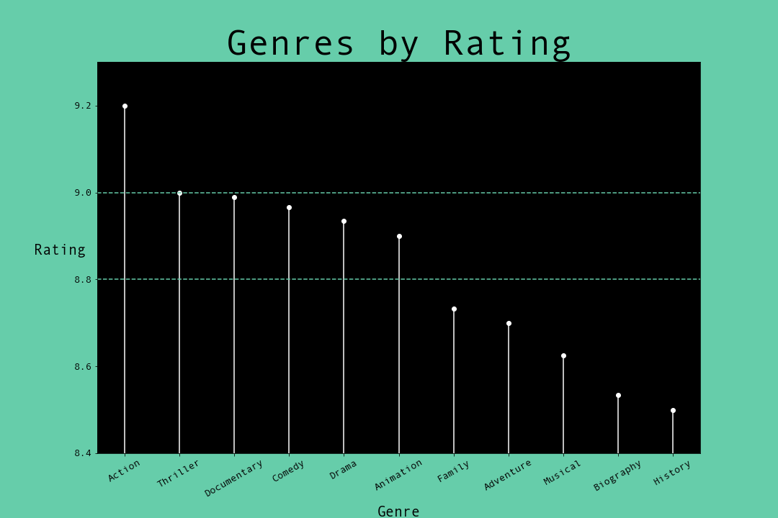
Results
POPULAR GENRES
The highest rated genre was Action
Other popular genres are Thriller, Documentary, Comedy, Drama, and Animation.

Slide 8
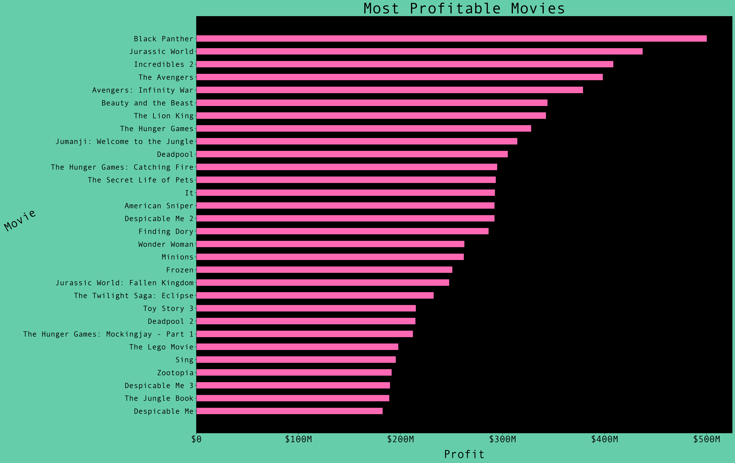
Results
PROFITABLE MOVIES
13 were in the action genre,
All but 1 were part of a franchise
6 of these were super-hero / comic book movies
15 were in the animation or computer-generated graphic genre, many franchises as well

Slide 9
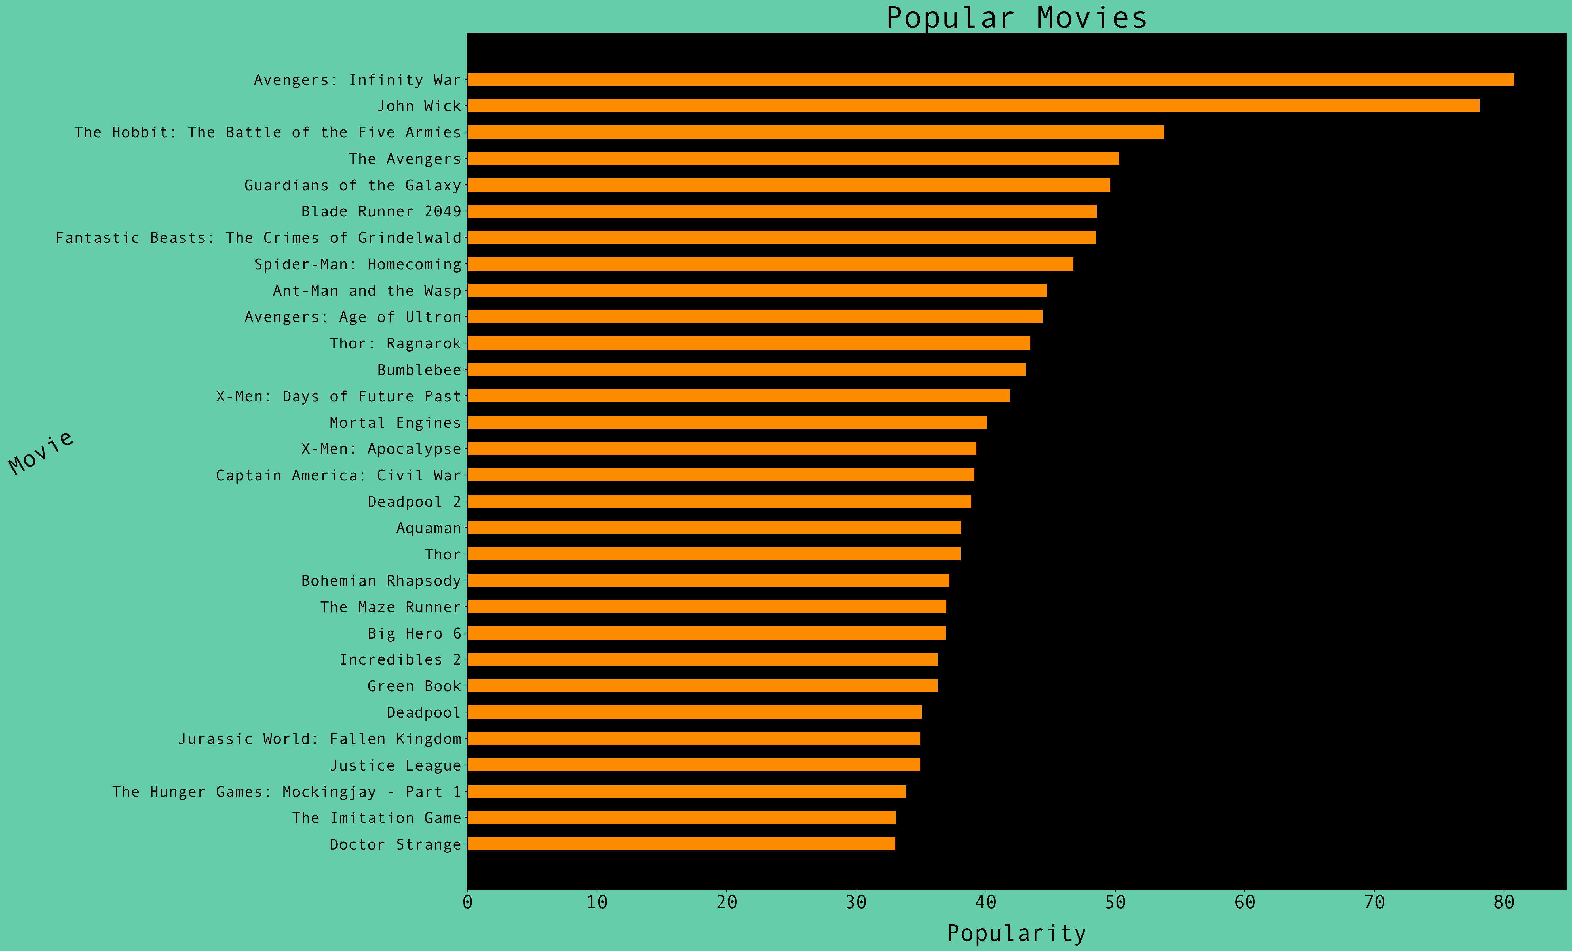
Results
POPULARITY SCORE
22 were in the action genre, 19 were part of a franchise
16 were super-hero / comic book franchises
3 were animation
3 were drama
2 were fantasy/adventure franchises

Slide 10
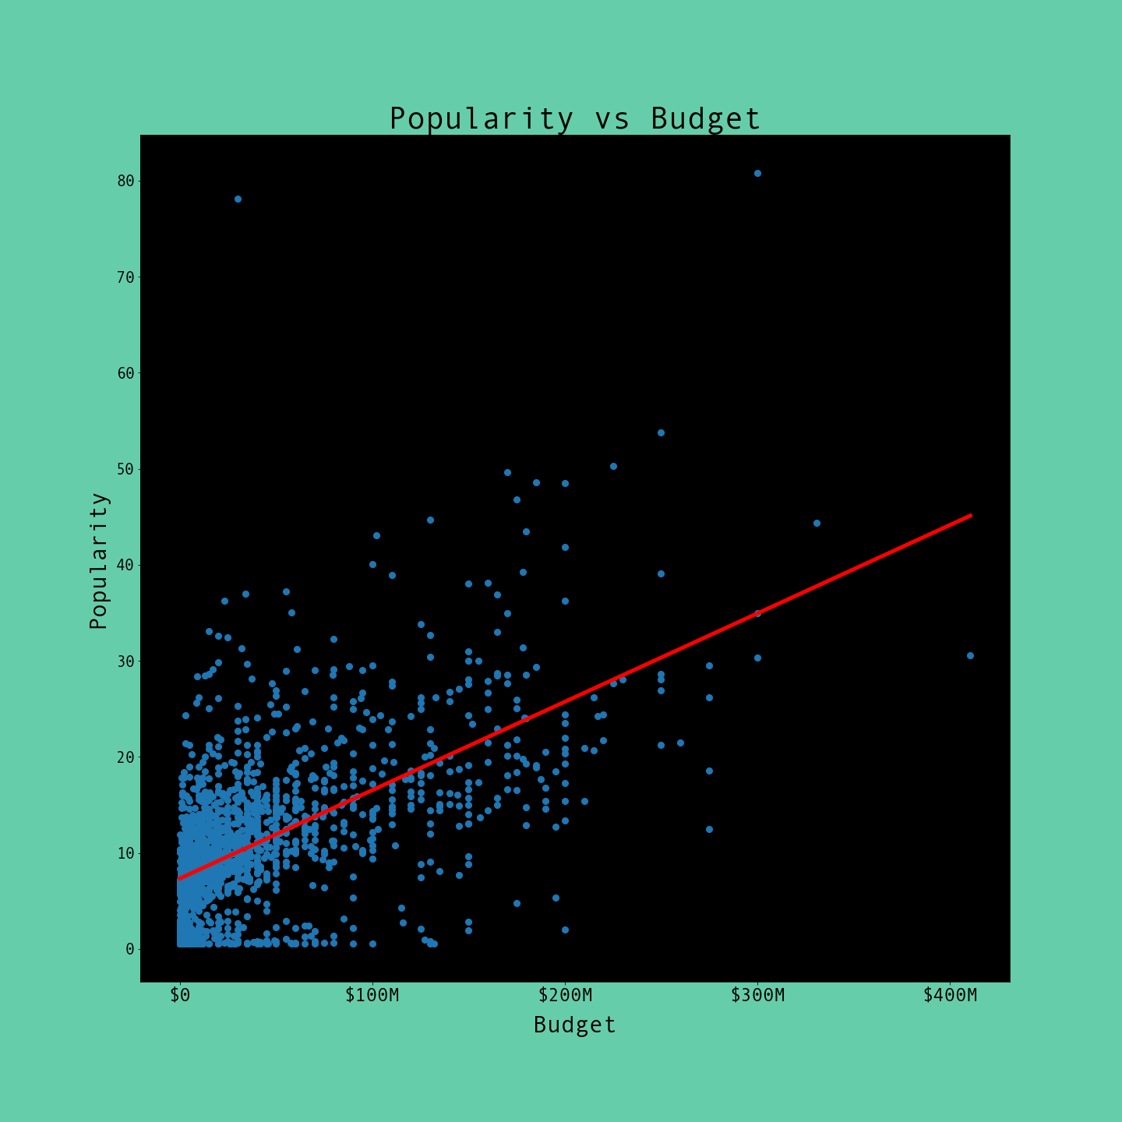
Results
There is a slight positive correlation between popularity and higher budgets

Slide 11
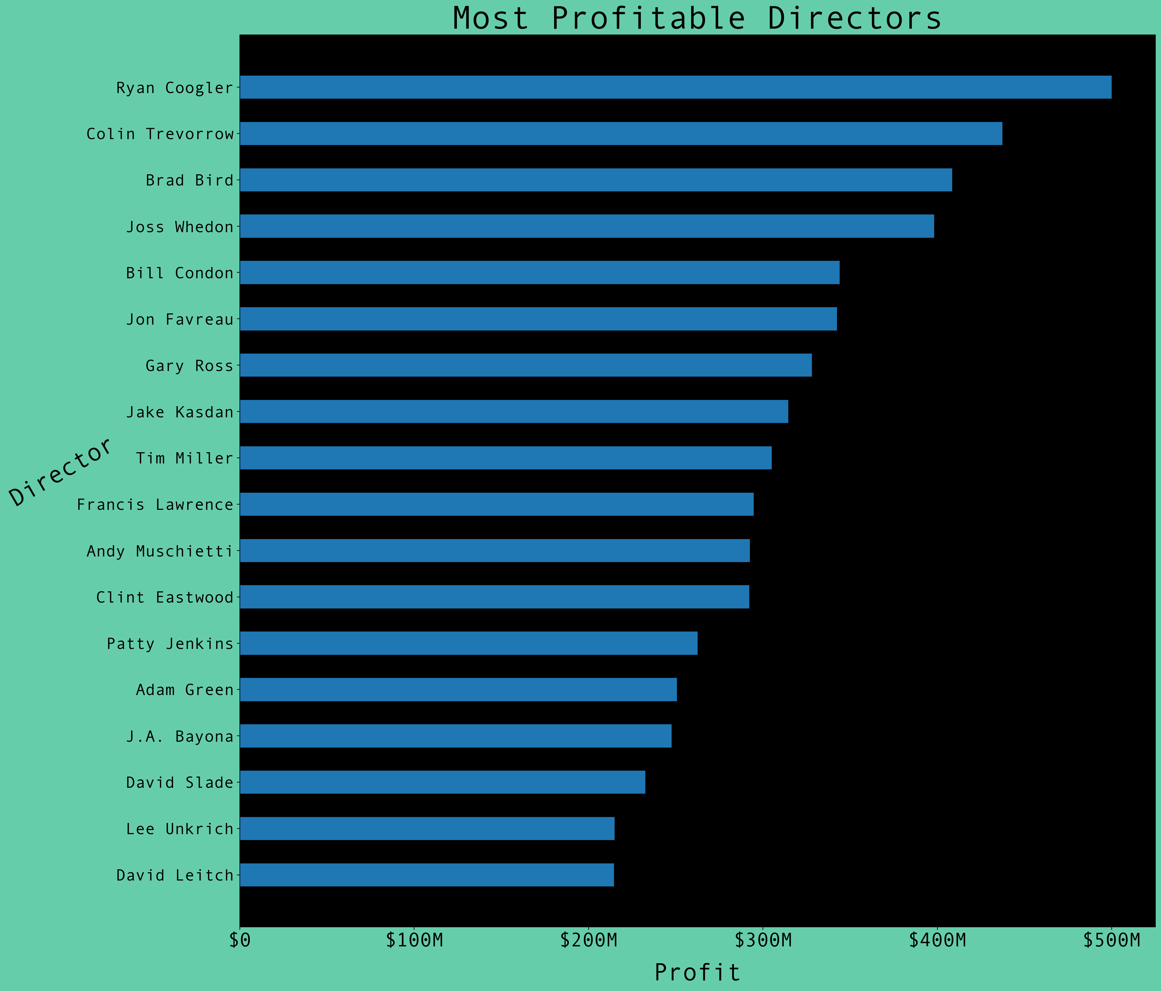
Results
MOST PROFITABLE DIRECTORS
These 20 directors were at the helm of the most profitable movies.

Slide 12
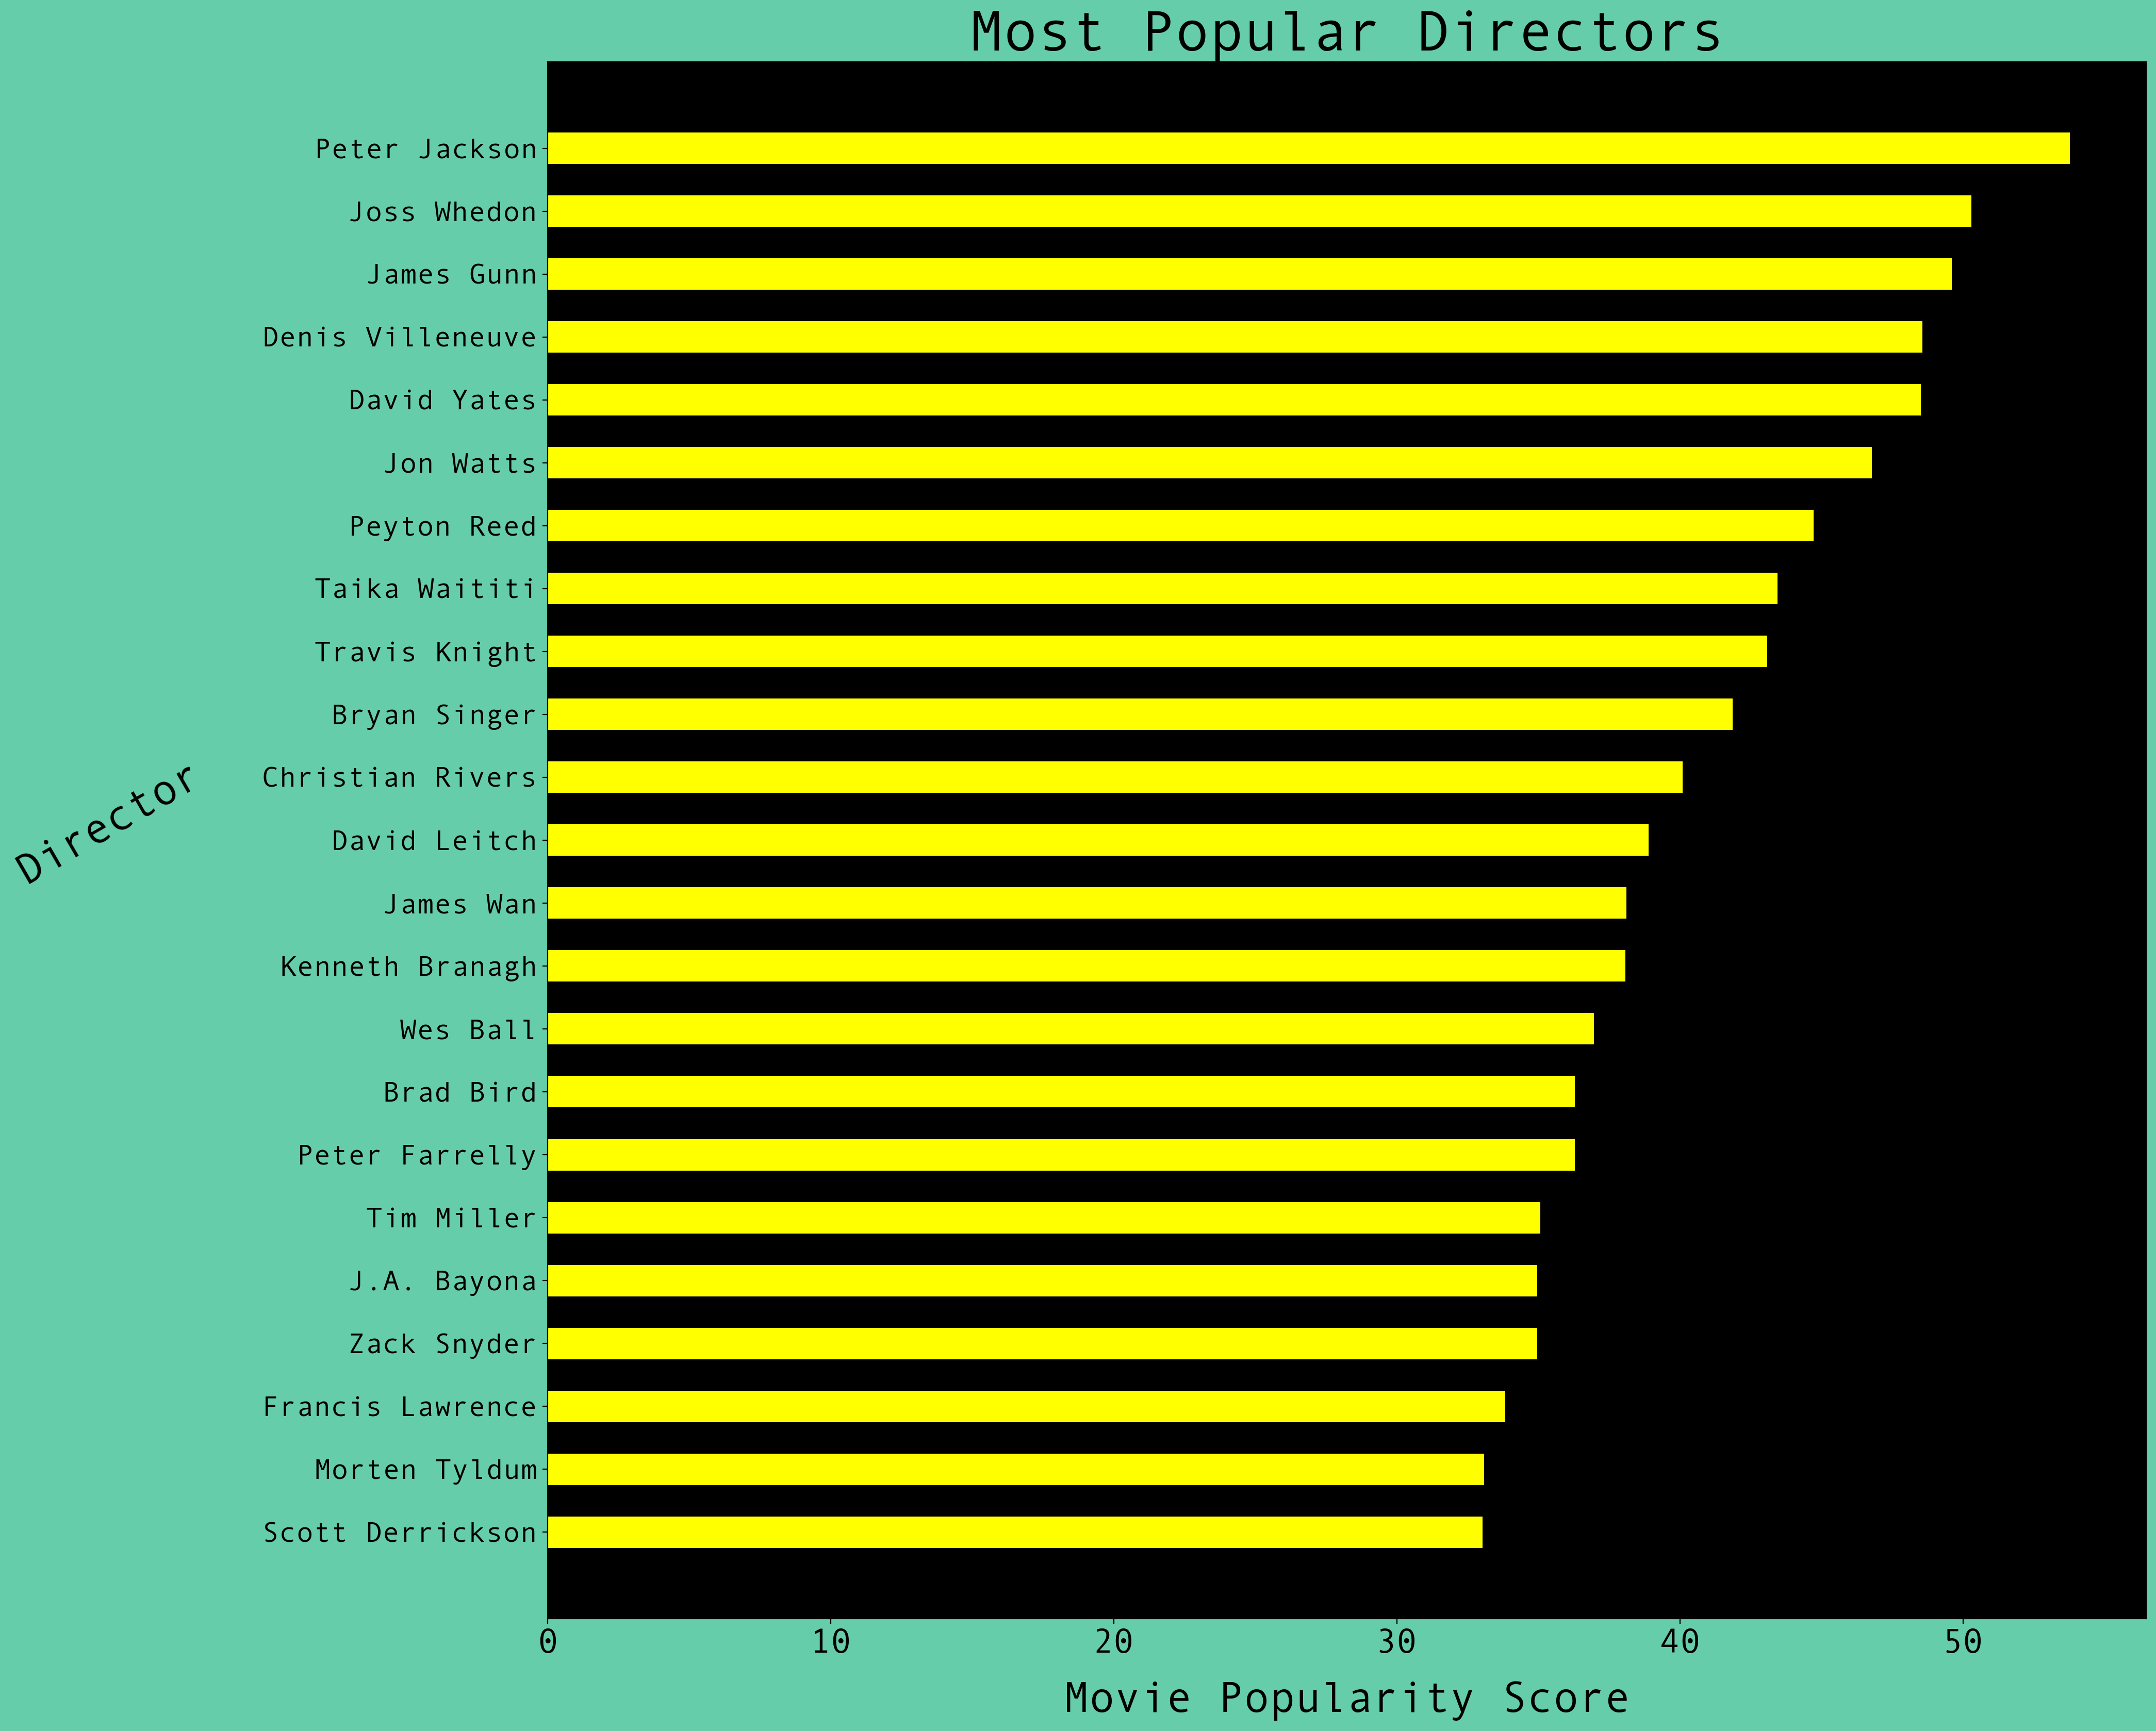
Results
MOST POPULAR DIRECTORS
These 20 directors were at the helm of the most popular movies.

Slide 13
Conclusions
Microsoft should acquire the rights to a super-hero / comic book franchise, or possibly another type of action franchise
______
The most popular and profitable genre is action
The most successful movies by both profitability and popularity were in the superhero / comic book sub-genre and all were franchises

Slide 14
Conclusions
Microsoft should produce animated movies
15 of the top 30 most profitable were animation

Slide 15
Conclusions
Microsoft should attach top grossing and popular directors
They are the leaders on set
Bring buzz and notoriety,
as well as top talent
and collaborative investment

Slide 16
Questions
Thank You!
Email: sudomakecoffee1@gmail.com
GitHub: @patrick-anastasio
LinkedIn: linkedin.com/in/patrickanastasio/

